Slide 1
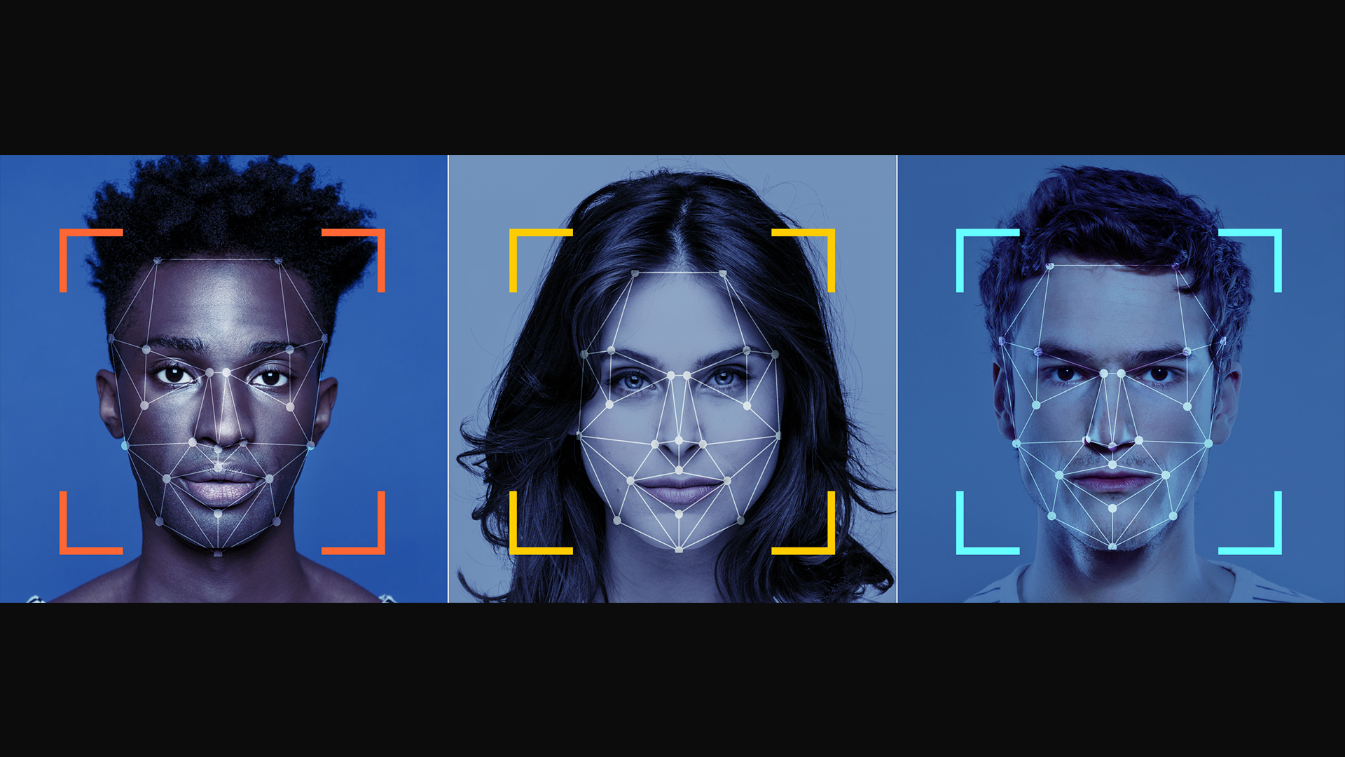
Facial Emotion Recognition Using CNNs
Name: SHAHD MOHMED HAZBER
ID: 202209766

Slide 2
Introduction
Use CNNs to recognize human facial emotions. The proposed model implemented using Python, and its performance evaluated to determine its effectiveness.
CNNs are particularly efficient in analyzing visual data and have demonstrated high success rates in tasks such as image recognition, object detection, and facial emotion recognition.
Recognizing human facial expressions is a challenging task for computer algorithms. computers do not possess emotions and lack the ability to comprehend what it means to feel happiness or sadness.
1)importing&uploading
2)Data visualization
3)Convert categorical to numeric
4)Data preprocessing
5)Splitting
6)Create CNNs model to training ,evaluating and using it to predict.
Facial expressions play a crucial role in human interactions and daily life.

Slide 3
Literature Review
(Ghaffar, F. 2020) :
He developed a CNN-based system to recognize seven basic emotional expressions. Images from the JAFFE and KDEF datasets were pre-processed—using face detection and data augmentation—to improve predictive performance. The architecture involved three convolutional layers followed by pooling and dense layers. Although experimenting with different numbers of CNN layers showed that adding more layers increased execution time without significantly boosting accuracy, the best configuration reached 70.2% accuracy, outperforming established networks like AlexNet and ResNet.
Two approaches were explored: one using autoencoders and another utilizing an 8-layer CNN. The autoencoder method compressed image data into lower-dimensional representations and delivered moderate performance, particularly on a homogenous dataset (Japanese women). In contrast, the 8-layer CNN provided better results on the LFW dataset, indicating that the CNN approach is more robust for emotion recognition tasks when trained on similar image resolutions and representations.
(Dachapally, P. R., 2017)
(Ahmed, T. U., Hossain, S., Hossain, M. S., ul Islam, R., & Andersson, K. 2019) :
They emphasizes the benefits of combining data augmentation with CNNs. By integrating images from multiple datasets and applying various augmentation techniques, the model achieved high validation accuracy. Additionally, a user-friendly graphical interface was developed to facilitate real-time validation. The study underscores the importance of balanced recognition rates across all seven emotion classes. And the accuracy for the model was 96.24%

Slide 4








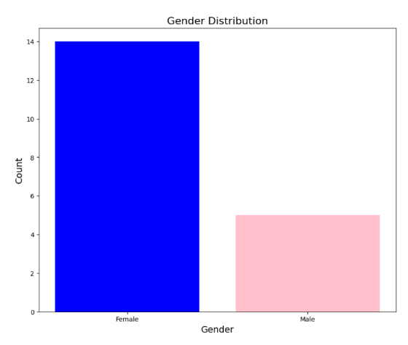
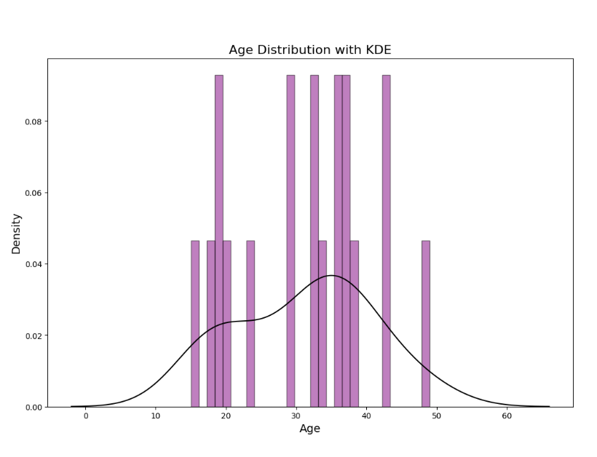
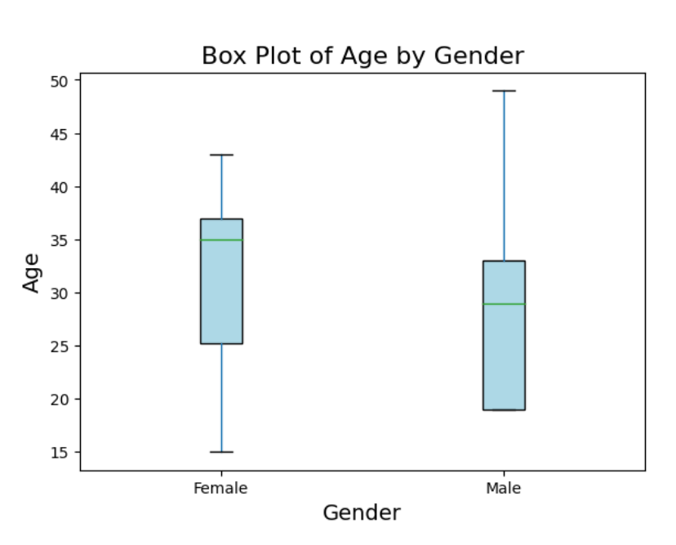
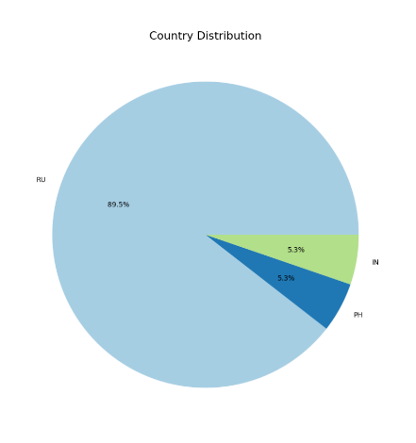
Happy
Exploration
DATASET
Sad
Fear
Neutral
Surprised
Disgust
Happy
Anger
Contempt
Gender Distribution
Age Distribution
(KDE)
Box Plot of Age by Gender
Country Distribution

Slide 5
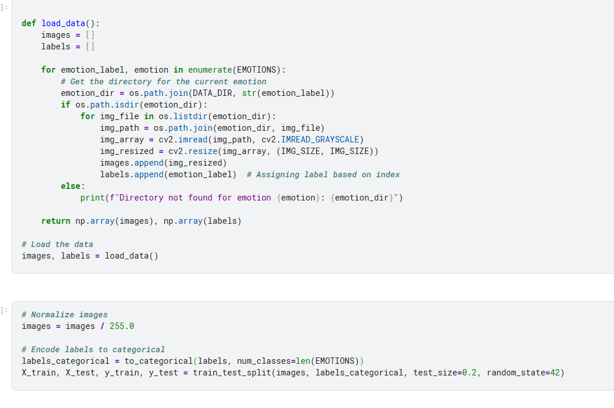
Pre-processing
Key Preprocessing Steps:
Normalization of image data.
Conversion of categorical labels to numerical values.
Data augmentation to expand dataset variability and reduce overfitting.
Rationale:
These steps are crucial to enhance the model’s learning capabilities and overall performance.

Slide 6
Implementation
Training model
Shows the image
Accuracy & Loss Models
Importing libraries
One subplot shows the model's accuracy changes during training (for both the training and validation data). The other subplot will show the model's loss changes over time.
For training the model using the data provided and evaluates its performance, using a function shows the accuracy of the model how it learned percentage.
shows the image along with its actual and predicted emotions label.

Slide 7
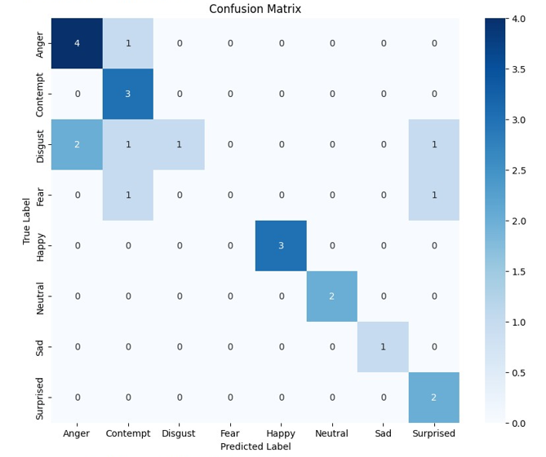
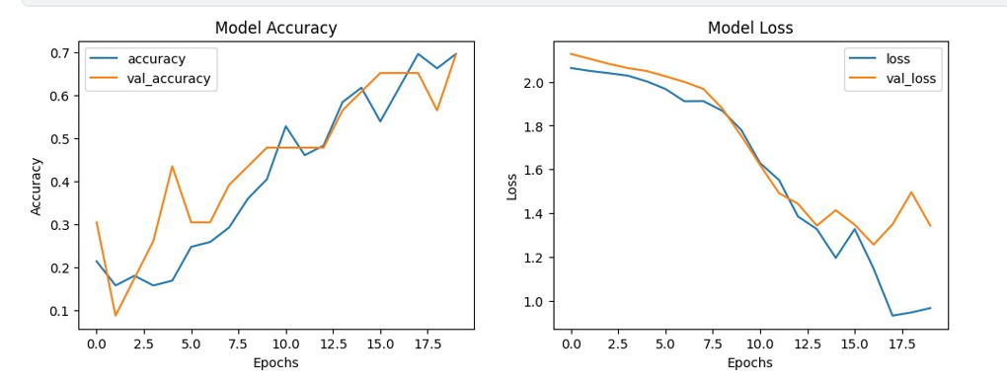
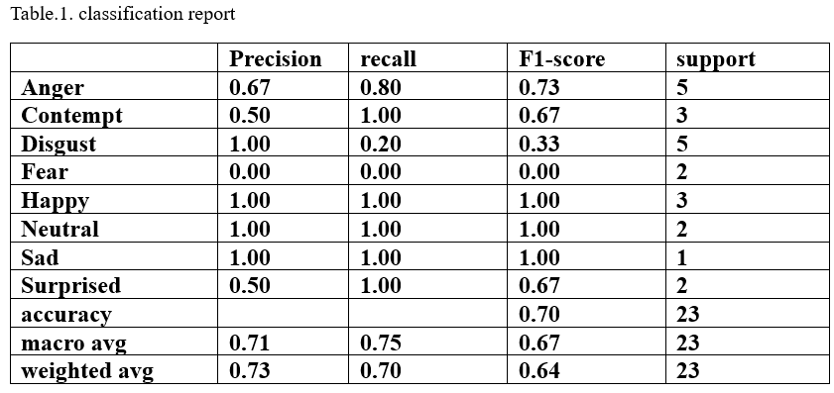
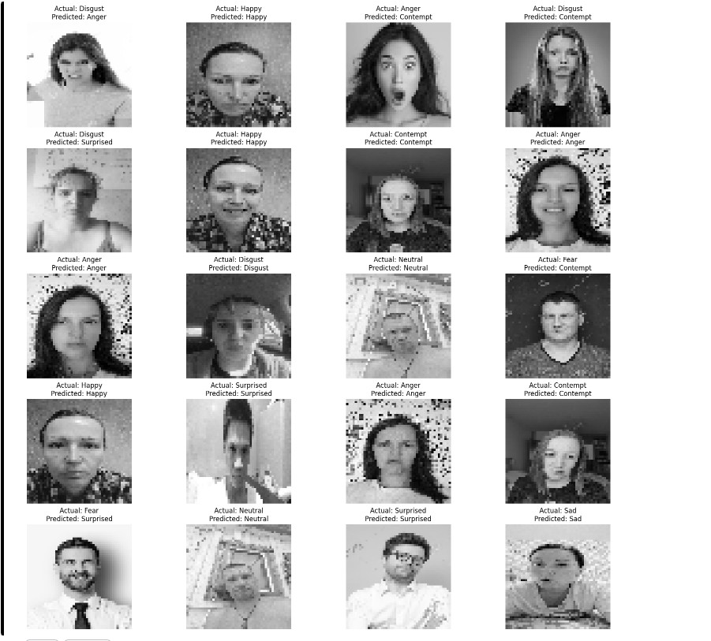
Result
01
Model & Loss accuracy
02
Confusion Matrix
03
Classification Report
04
Prediction
Notes:
Classification report

Slide 8



Conclusion
In the future, will developing models capable of handling diverse datasets & enhance the recognition of subtle and complex emotions.
Final accuracy of
69.57%
“Contempt” , “Happy” “Neutral”
“Sad” and “Surprised.
Confusion matrix & classification report are used to predict and evaluate the model.
“Fear” challenges for the model.
Trained on the images dataset to identify human facial expressions using CNNs.
Thanks for listening
Notes:
加一个微笑的表情

